Slide 1

LIBRARY MANAGEMENT SYSTEM
Submitted by –
Kenil Shah (B160632CS)
Manu Jose Philip (B160158CS)
Malhar Shirswar (B160511CS)
G. Bharath (B160653CS)
Notes:
NOTE:
To change the image on this slide, select the picture and delete it. Then click the Pictures icon in the placeholder to insert your own image.

Slide 2
INTRODUCTION
Library management system is a project which aims in developing a computerized system to maintain all the daily work of a library.
This project contains many features which are generally not available in normal library management systems.
The project is developed to help the students as well as staff of library to maintain the library in the best way possible and also reduce the human efforts.

Slide 3
Scope of Project
To make the existing system more efficient.
Making the functionality of Library better.
To have an online portal for students to access features of library.
To make it easier for Librarian to manage the Library.
To provide a user friendly interface for students and librarian.

Slide 4
Languages used for development
Front-end development:
HTML
CSS
JS
Back-end development:
PHP
MYSQL

Slide 5
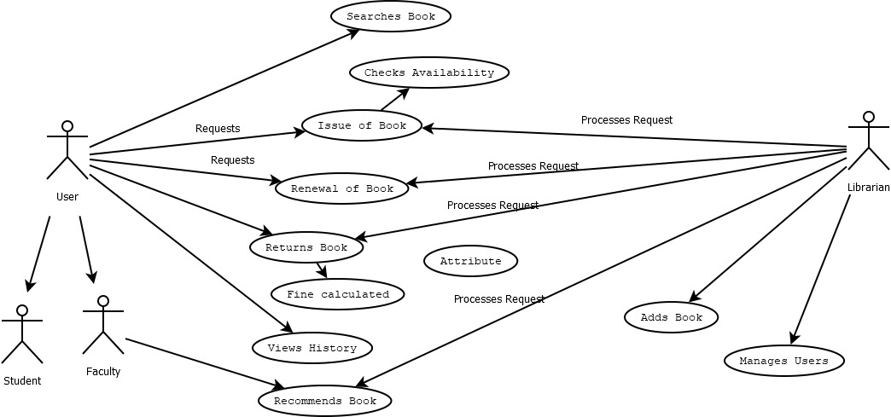
Control Flow Diagram

Slide 6
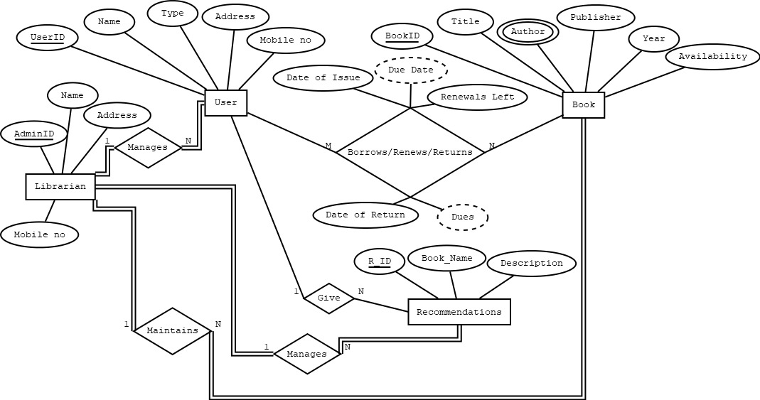
Entity Relationship Diagram

Slide 7
System Features
Admin
Add and update books
Manage users
Send messages
View Recommendations
Process issues/renews/requests
View currently issued books
Student
View and update profile details
View/issue/renew books
Recommend a book
View currently issued books
View previously issued books

Slide 8
Database Tables
USER
Field | Data type | Default | Key
RollNo | VARCHAR(20) | Not NULL | Primary key
Name | VARCHAR(255) | NULL
Type | VARCHAR(255) | NULL
Category | TEXT | NULL
Password | VARCHAR(20) | NULL
Field | Data type | Default | Key
RollNo | VARCHAR(20) | Not NULL | Primary key
Email | VARCHAR(255) | NULL
Field | Data type | Default | Key
RollNo | VARCHAR(20) | Not NULL | Primary key
MobileNo | INTEGER(10) | NULL

Slide 9
Database Tables
BOOKS
Field | Data type | Default | Key
BookID | VARCHAR(20) | Not NULL | Primary key
Title | VARCHAR(255) | NULL
Publisher | VARCHAR(255) | NULL
Year | YEAR(4) | 0000
Availability | INT(100) | 0
AUTHOR
Fieldd | Data type | Default | Key
BookID | VARCHAR(20) | Not NULL | Foreign key
Author | VARCHAR(20) | Not NULL

Slide 10
Database Tables
BOOK RECORD
Field | Data type | Default | Key
RollNo | VARCHAR(20) | Not NULL | Foreign Key
BookID | VARCHAR(20) | Not NULL | Foreign Key
Date_Of_Issue | DATE | 1000-01-01
Due_Date | DATE | 1000-01-01
Date_Of_Return | DATE | 1000-01-01
Dues | INT(10000) | 0
Renewals_Left | INT(10) | 0
RENEW
Field | Data type | Default | Key
RollNo | VARCHAR(20) | Not NULL | Primary key
BookId | INTEGER(10) | NULL
RETURN
Field | Data type | Default | Key
RollNo | VARCHAR(20) | Not NULL | Primary key
BookId | INTEGER(10) | NULL

Slide 11
Database Tables
RECOMMENDATIONS
Field | Data type | Default | Key
R_ID | VARCHAR(20) | Not NULL | Primary Key
Book_Name | VARCHAR(255) | NULL
Description | TEXT | NULL
RollNo | VARCHAR(20) | Not NULL | Foreign Key
MESSAGES
Field | Data type | Default | Key
M_ID | INT(3) | Not NULL | Primary Key
RollNo | VARCHAR(255) | Not NULL | Foreign Key
Msg | TEXT | NULL
Date | DATE(4) | NULL
Time | TIME(4) | NULL

Slide 12
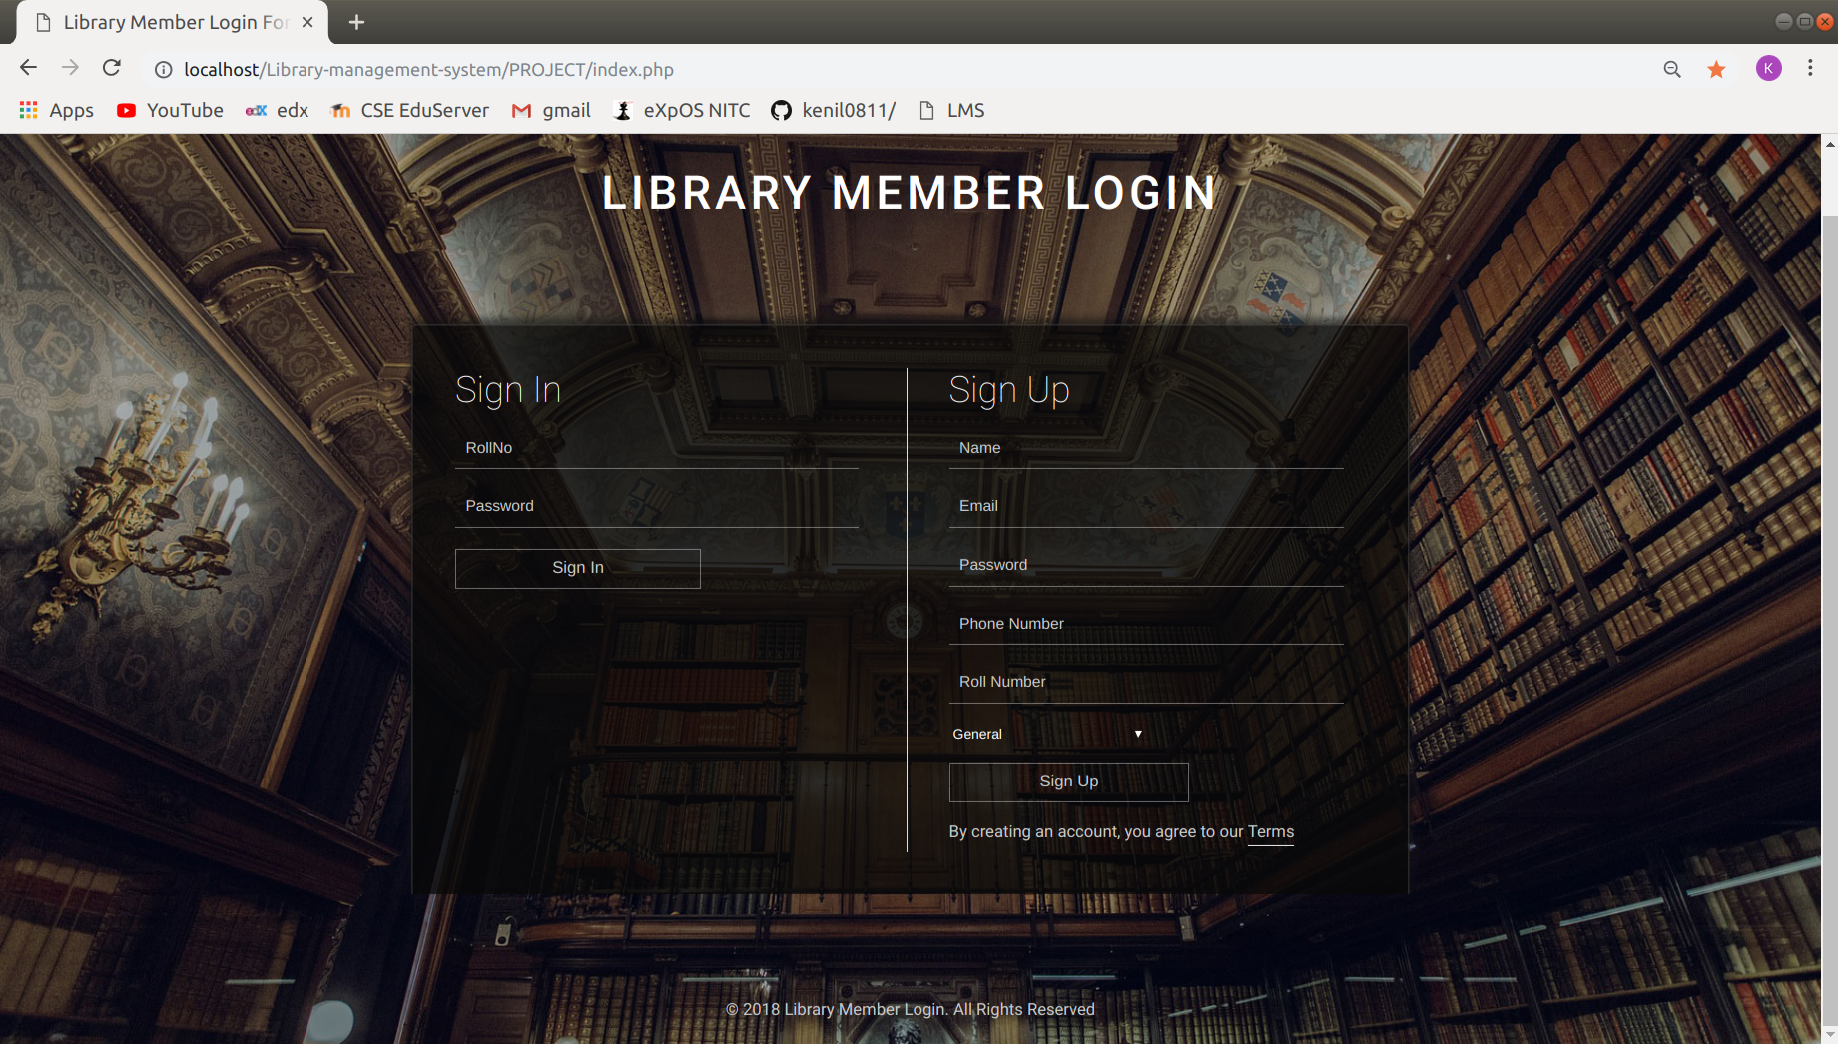
Screenshots
Login Page

Slide 13
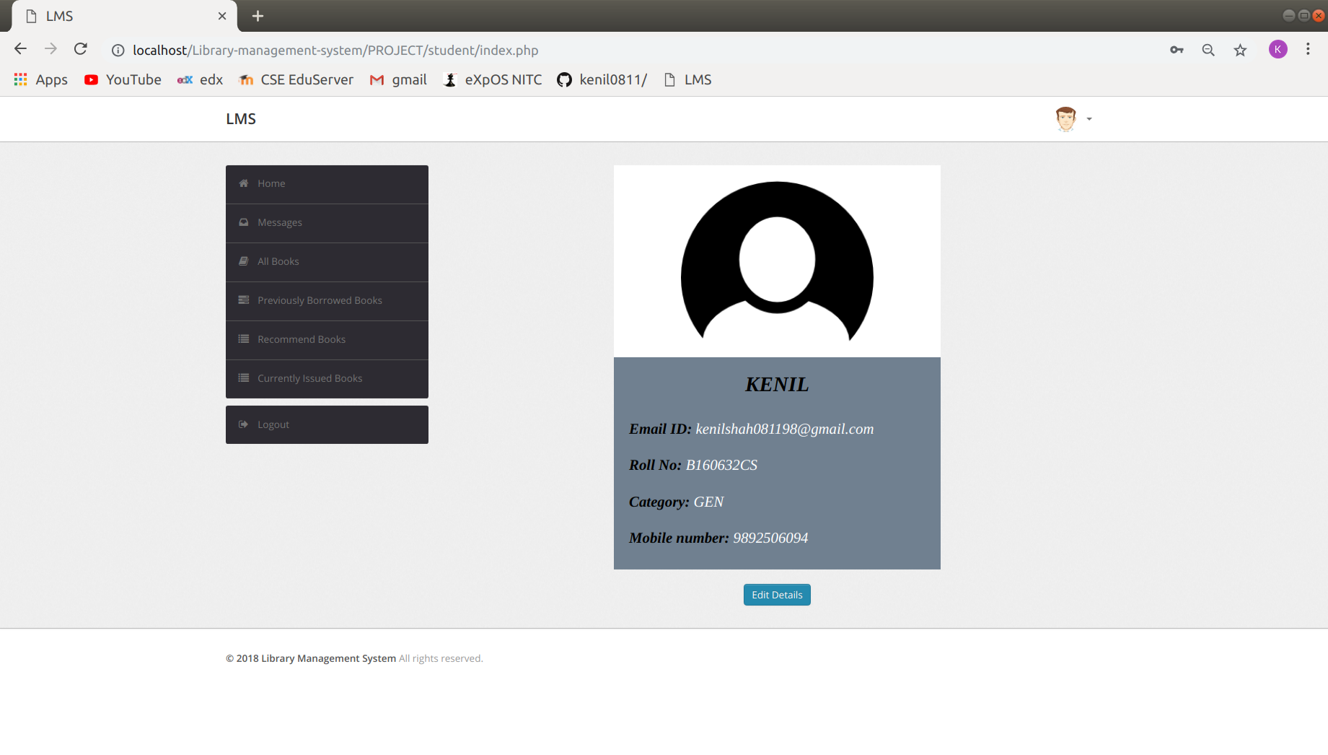
Screenshots
Home page

Slide 14
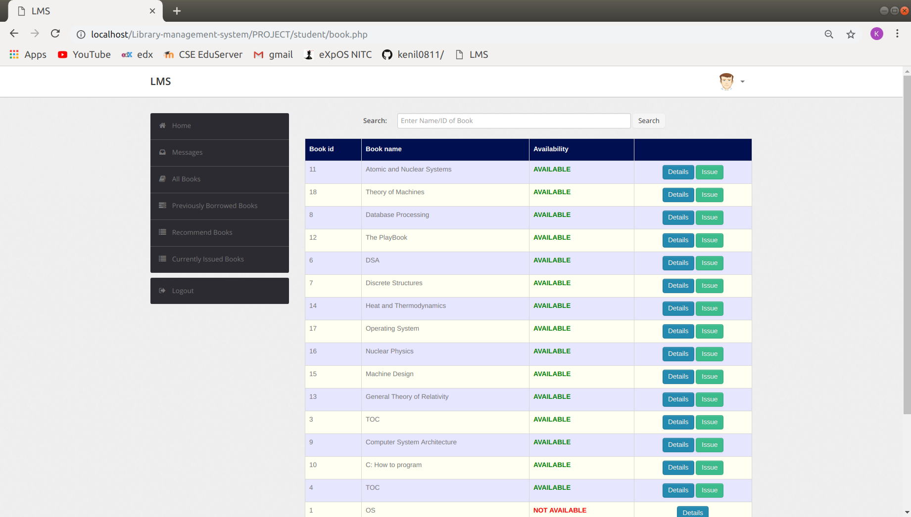
Screenshots
View Books

Slide 15
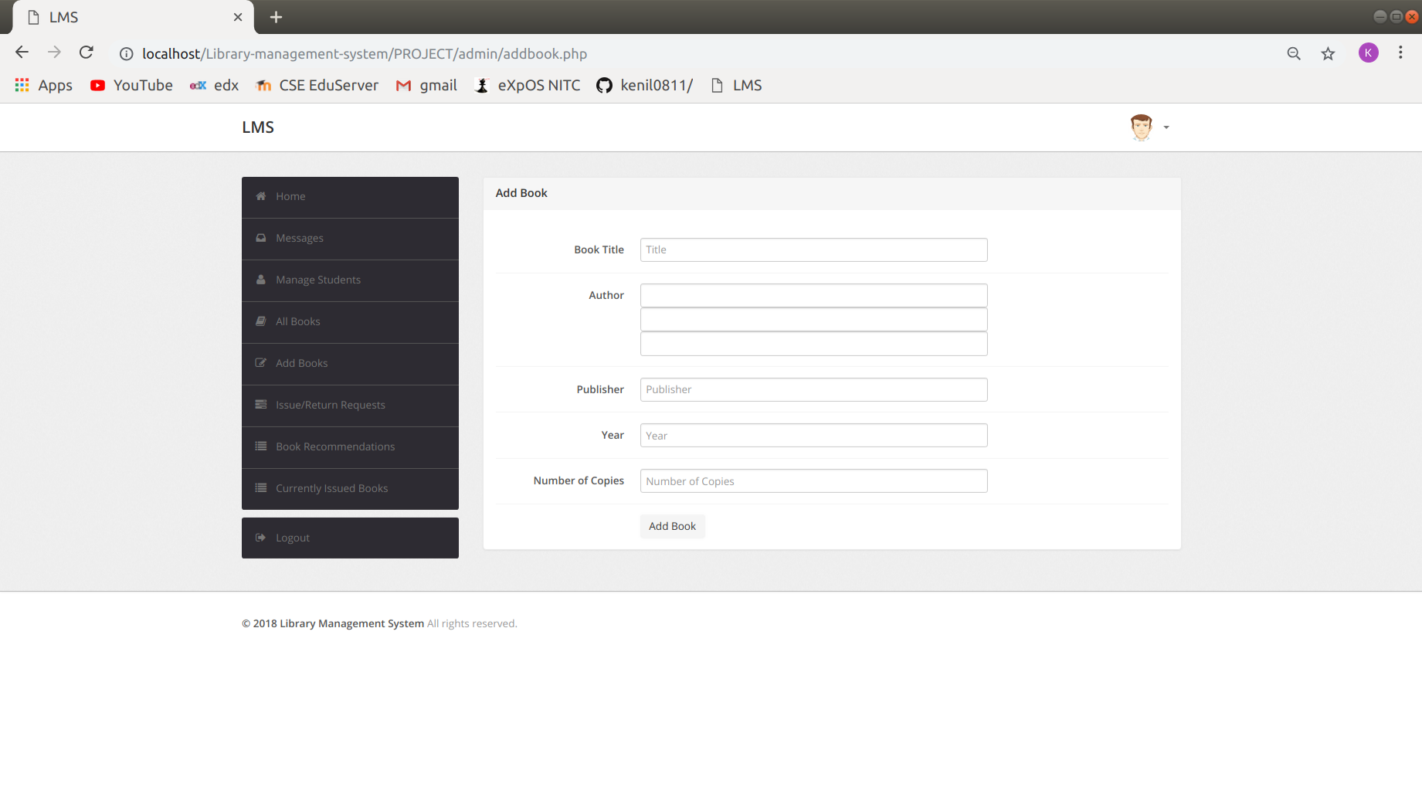
Screenshots
Add Books

Slide 16
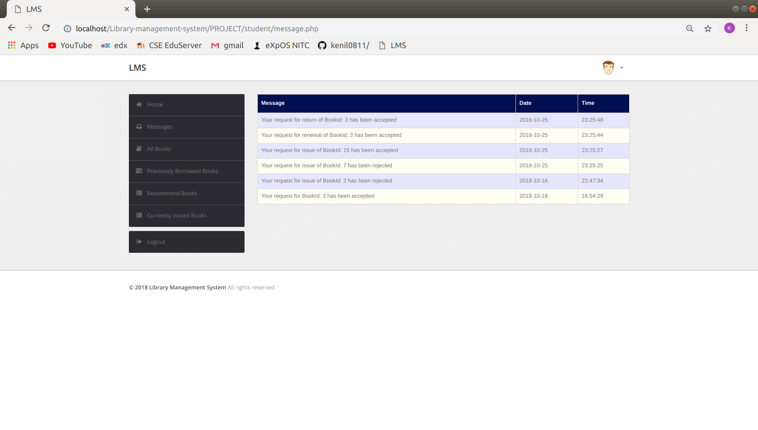
Screenshots
View messages

Slide 17
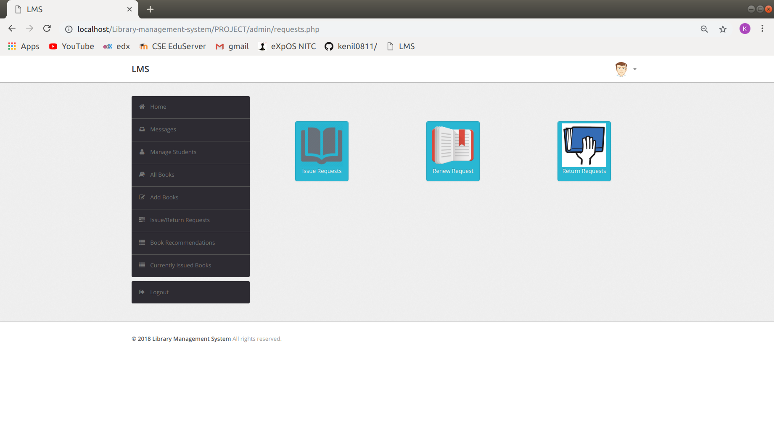
Screenshots
Process requests

Slide 18
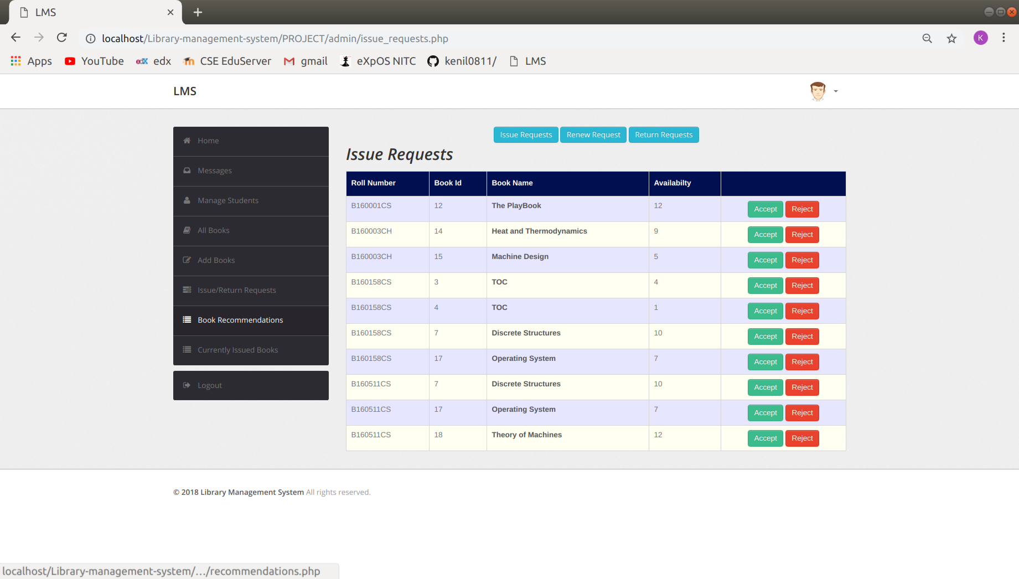
Screenshots
Issue requests

Slide 19
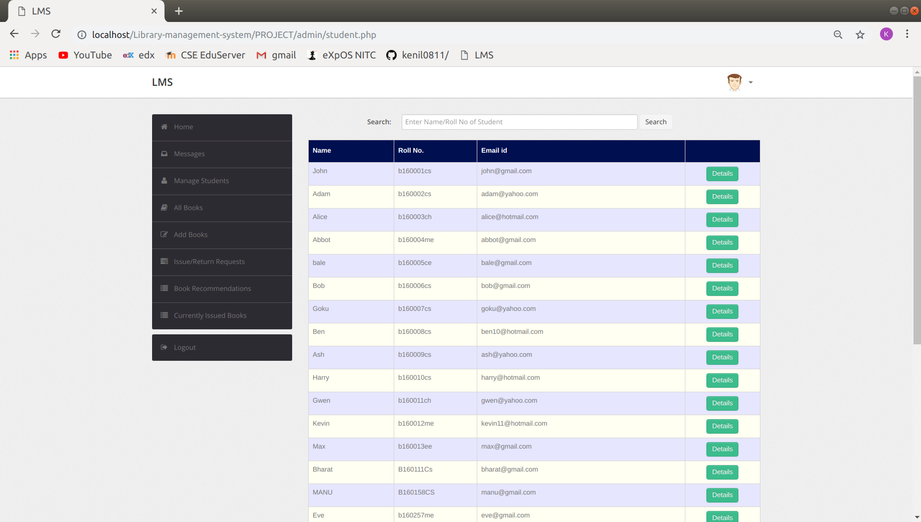
Screenshots
View Students

